Slide 1
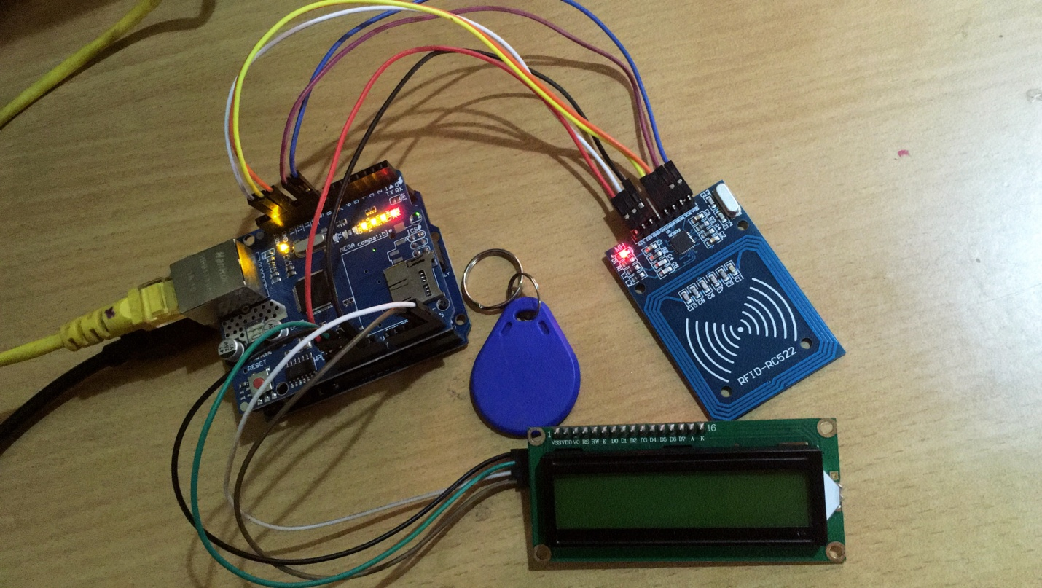
Lab Monitoring System using RFID

Slide 2
WHAT?
Lab Monitoring System is a device that monitors the data of all the people who are using the computer Lab.
WHY?
To manage the lab security in terms of the problems like device theft, physical damage to hardware and also to keep track of the list of persons utilizing the lab.
HOW?
Using RFID - Radio Frequency Identification technology. RFID is a small wireless tag that help to identify objects and people. These tags do not require a battery to power up and in turn, they derive power from the electromagnetic field generated from the RFID reader with the help of Arduino Uno.

Slide 3
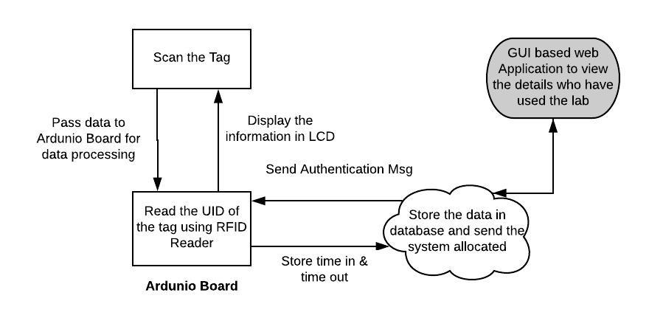
Software Architecture

Slide 4
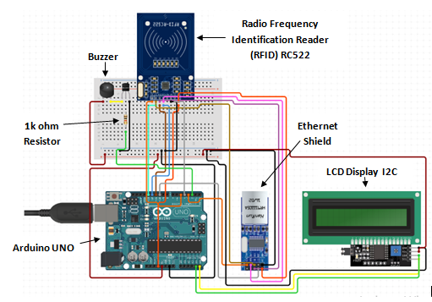
Hardware Architecture

Slide 5
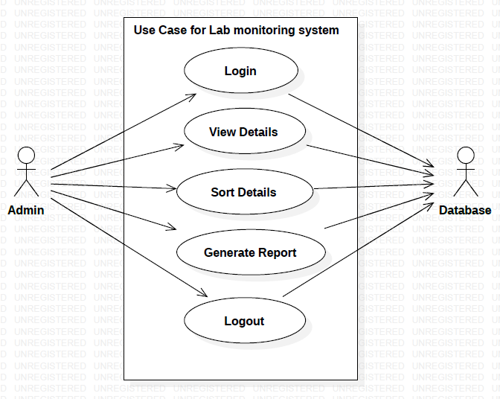
Use Case Diagram

Slide 6
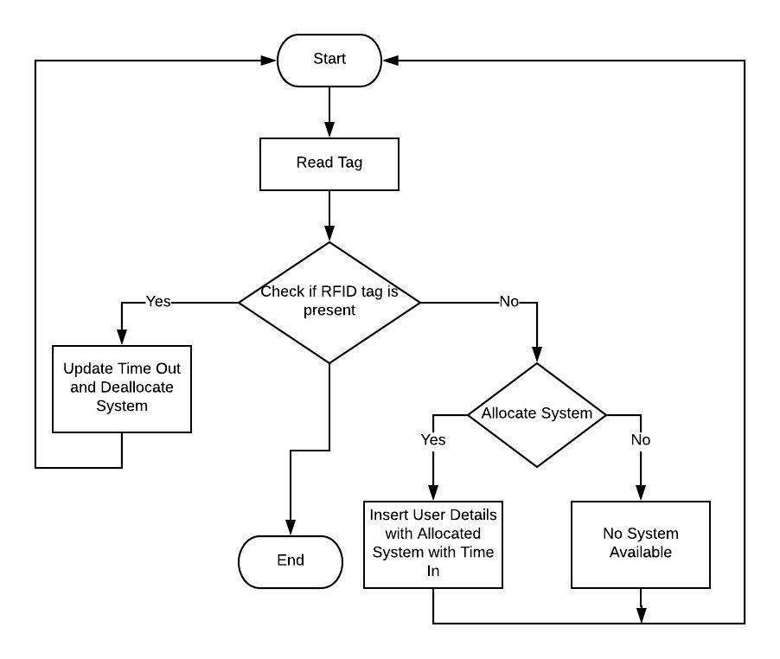
Activity Diagram

Slide 7
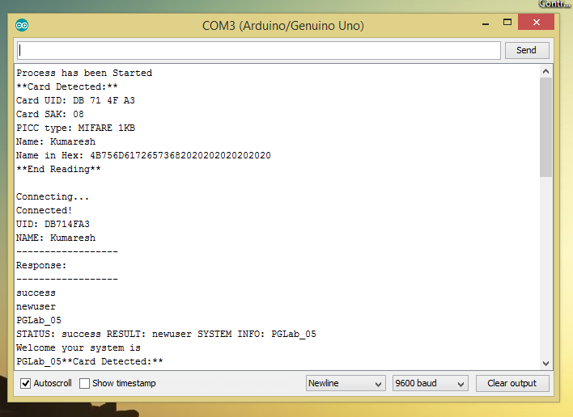
Output Entry on new user in computer lab – system allocation process

Slide 8
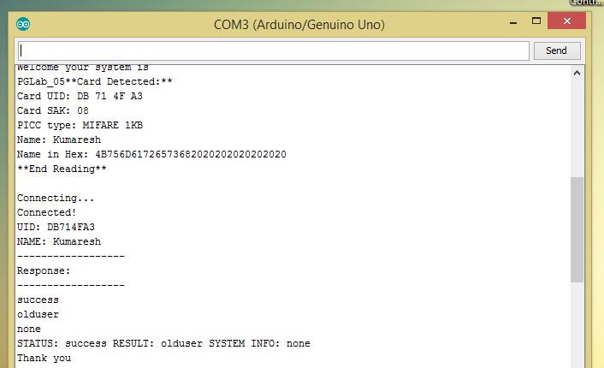
Output Entry of old user in computer lab – system de allocation process

Slide 9
Thank you

